Slide 1
4-bit Computer using VerilogHDL
Name: Sohan Salahuddin Mugdho
ID: 1606099

Slide 2
Defining Instruction Set
No. | Instruction | Assembly Key | Machine Code(Decimal)
1 | ADD A,B | ADD_A_B | 0
2 | SUB A,B | SUB_A_B | 1
3 | XCHG B,A | XCHG_B_A | 2
4 | MOV A,[ADDRESS] | MOV_A_ADD | 3
5 | MOV [ADDRESS],B | MOV_ADD_B | 4
6 | JNZ ADDRESS | JNZ_ADD | 5
7 | XOR A,[ADDRESS] | XOR_A_ADD | 6
8 | PUSHF | PUSHF | 7
9 | IN B | IN_B | 8
10 | OUT A | OUT_A | 9
11 | JMP ADDRESS | JMP_ADD | 10
12 | PUSH A | PUSH_A | 11
13 | POP A | POP_A | 12
14 | CALL ADDRESS | CALL_ADD | 13
15 | RET | RET | 14
16 | HLT | HLT | 15

Slide 3
Example Program
Assembly Code:
Expected Result:

Slide 4
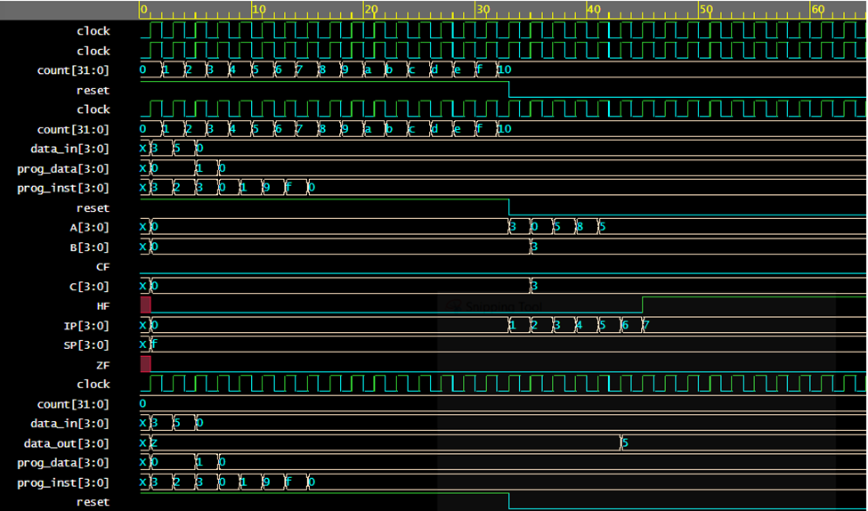
Result Waveform

Slide 5
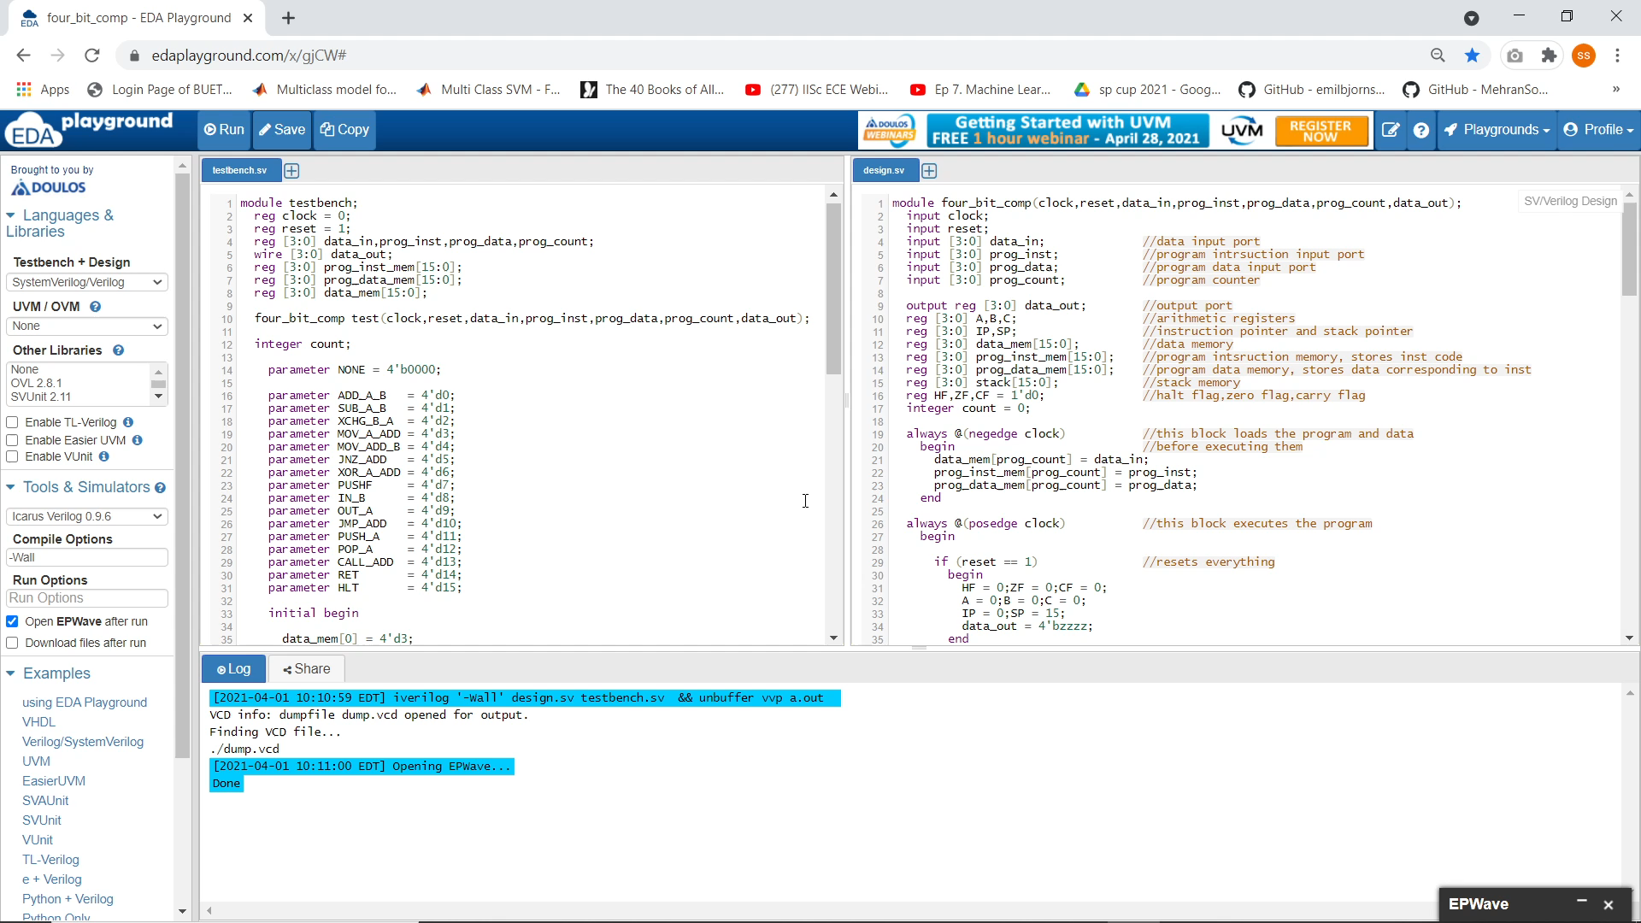
Video Demonstration
Video Link
EDAplayground Link

